Slide 1

Note: The data and information in this document is reflective of a hypothetical situation and client. This document is to be used for KPMG Virtual Internship purposes only.
Sprocket Central Pty Ltd
Data analytics approach
Analytics, Information and Modelling Team – Justine Picar

Slide 2
Note: The data and information in this document is reflective of a hypothetical situation and client. This document is to be used for KPMG Virtual Internship purposes only.
Agenda
Introduction
Data Exploration
Model Development
Interpretation

Slide 3
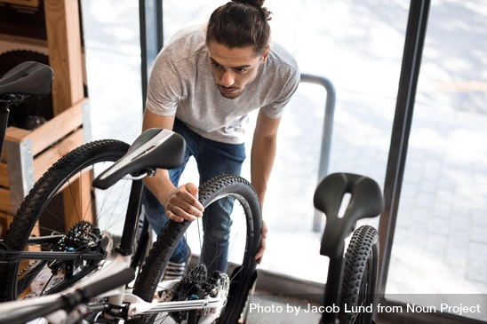
Note: The data and information in this document is reflective of a hypothetical situation and client. This document is to be used for KPMG Virtual Internship purposes only.
Introduction
TARGETING HIGH VALUE CUSTOMERS FOR SPROCKET CENTRAL PTY LTD.
Sprocket has been a long-standing KPMG client specializing in high-quality bikes and accessible cycling accessories.
Goal:
Determine customer patterns and behaviors of 1,000 new clients and properly allocate budget and resources based on our findings for the appropriate market segments using the following data from Sprocket’s marketing team:
Customer Demographics
Customer Addresses
Customer Transactions from Jan-Dec 2017

Slide 4
Note: The data and information in this document is reflective of a hypothetical situation and client. This document is to be used for KPMG Virtual Internship purposes only.
About the Dataset
Customer Demographics
Transactions
4000 customers
12 usable features
There are missing values, duplicates, and formatting issues
20,000 data points
13 usable features
There are missing values and formatting issues
Customer Addresses
Final Merged Dataset
3999 addresses
6 usable features
There are some formatting issues
20500 data points
Reformatted values, and identified 5 additional customers from transactions and addresses
Regrouped by features like tenure and age for more general granularity

Slide 5
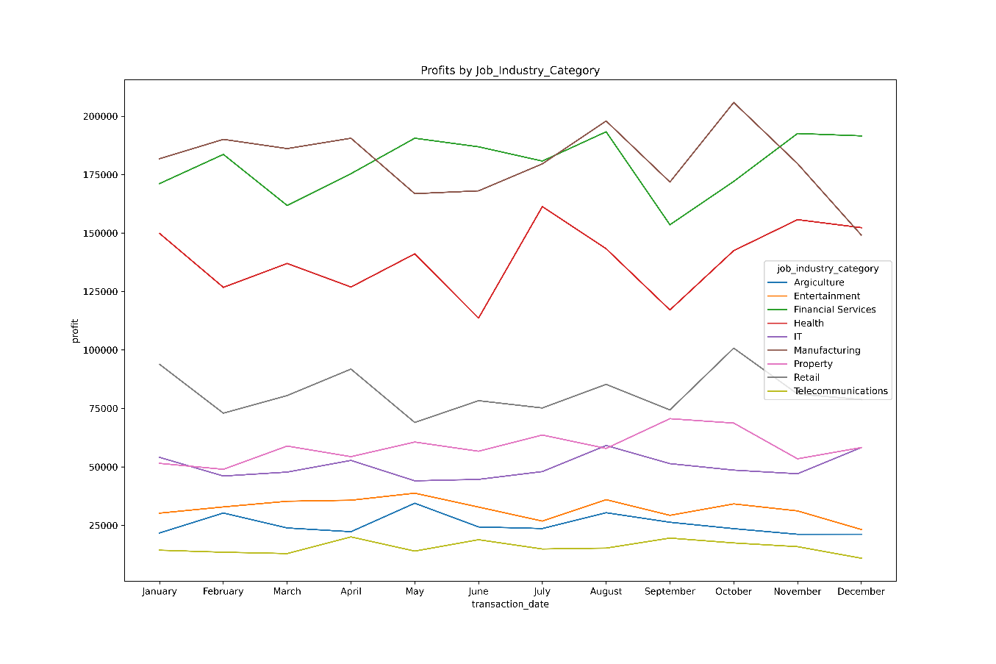
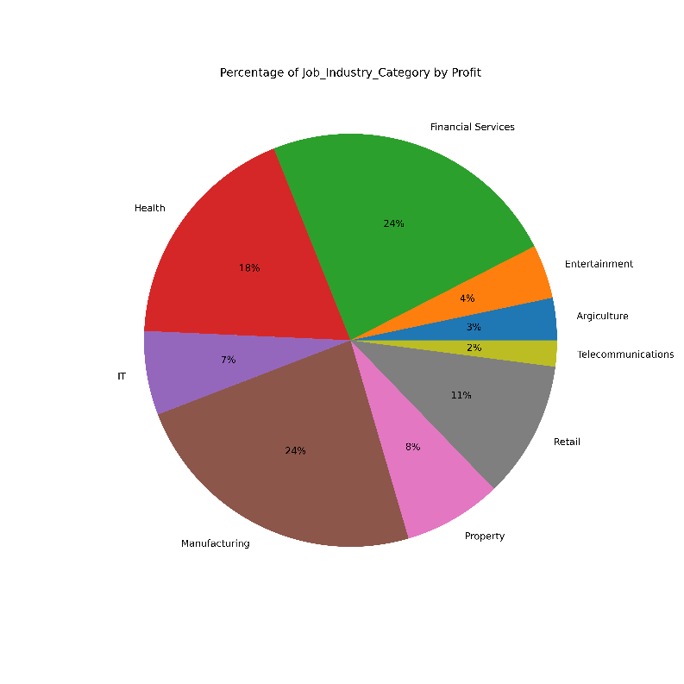
Note: The data and information in this document is reflective of a hypothetical situation and client. This document is to be used for KPMG Virtual Internship purposes only.
Data Exploration
Profit by Job Industry
Manufacturing, Financial Services, and Health make up a large proportion of customers and profit

Slide 6
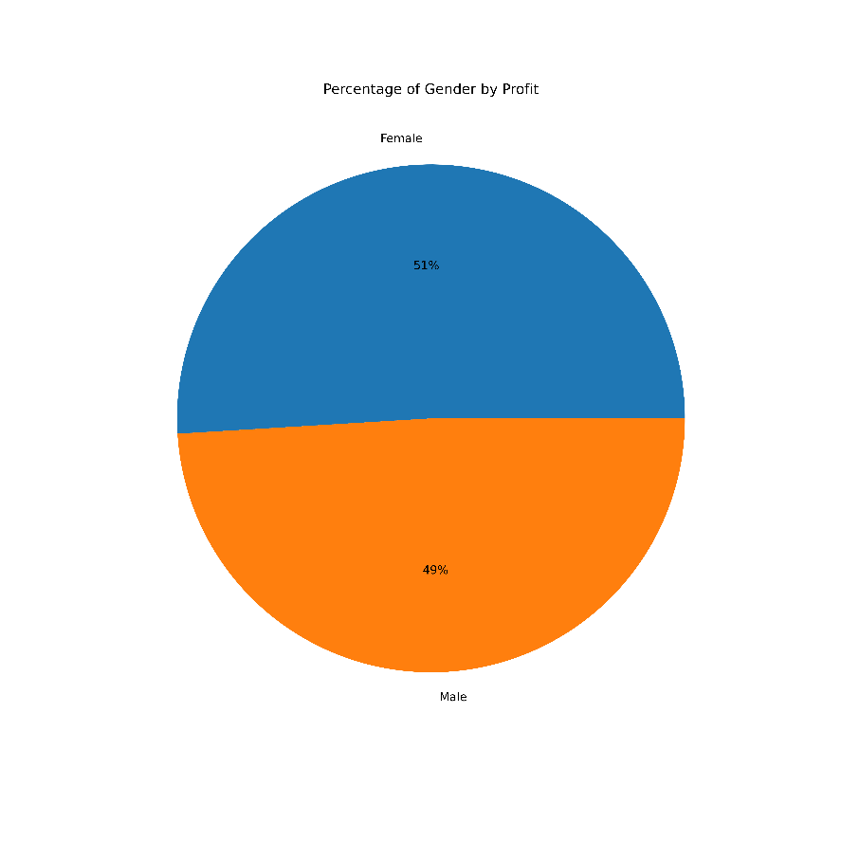
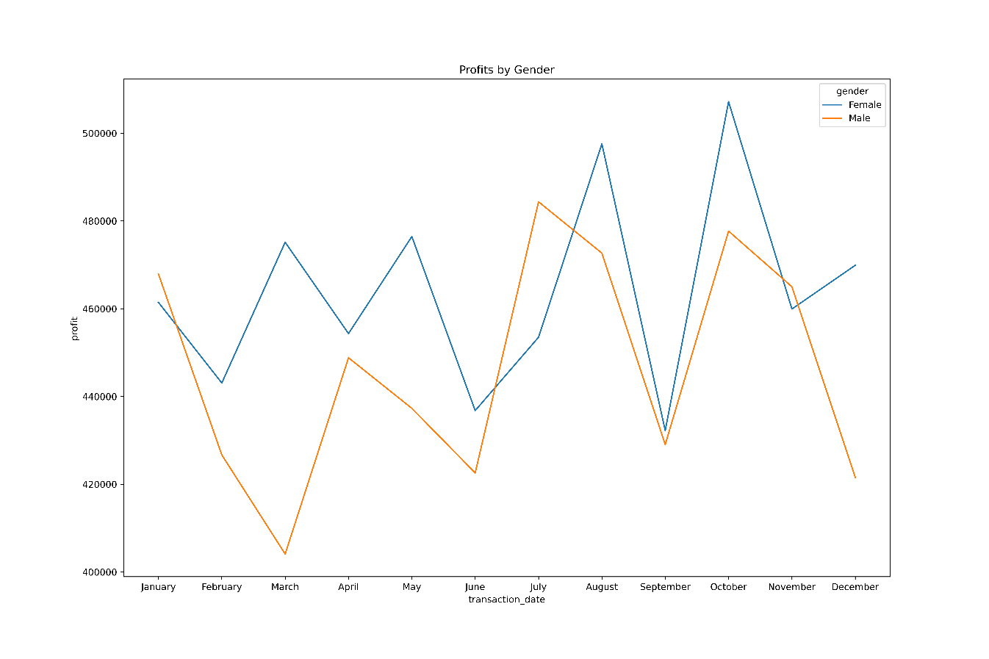
Note: The data and information in this document is reflective of a hypothetical situation and client. This document is to be used for KPMG Virtual Internship purposes only.
Data Exploration
Yearly Total Profit by Gender
Women spend slightly more than men. However, we should still consider both market segments.

Slide 7
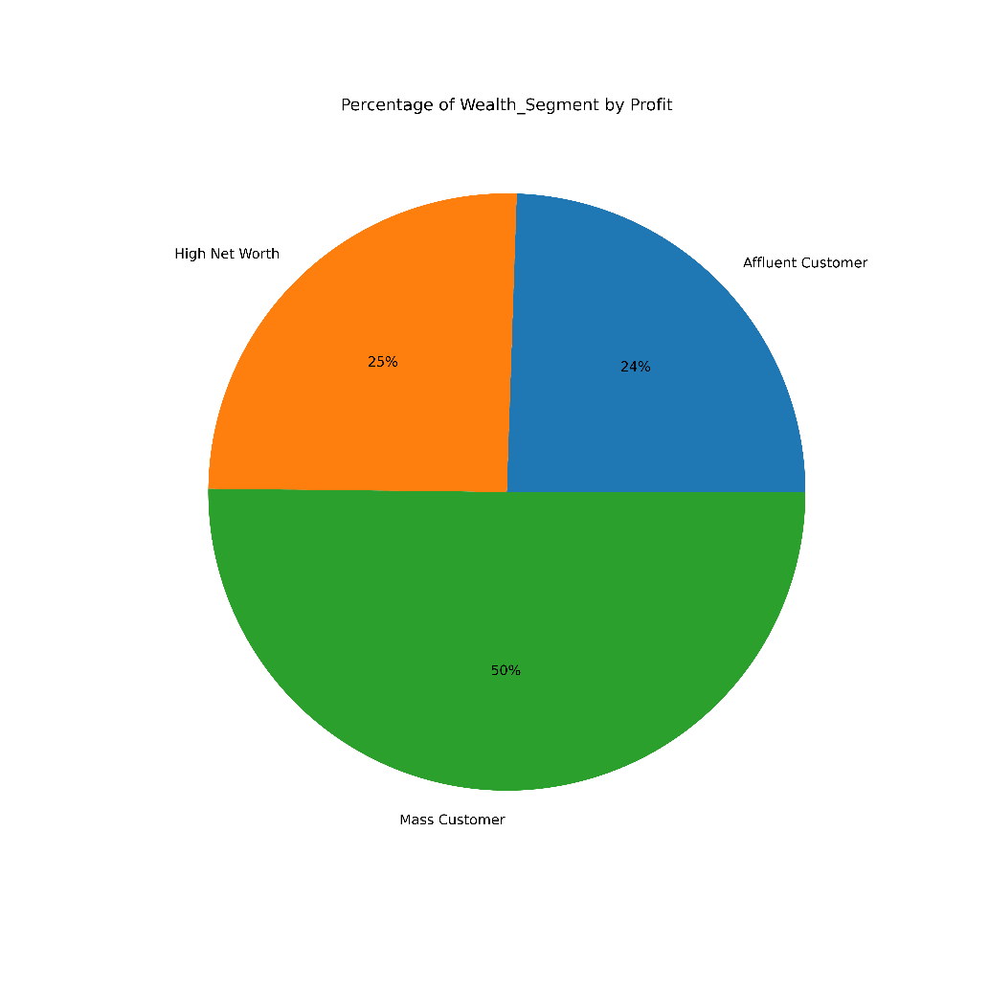
Note: The data and information in this document is reflective of a hypothetical situation and client. This document is to be used for KPMG Virtual Internship purposes only.
Data Exploration
Wealth Segment
Mass Customers make up 50% of total profits in 2017

Slide 8
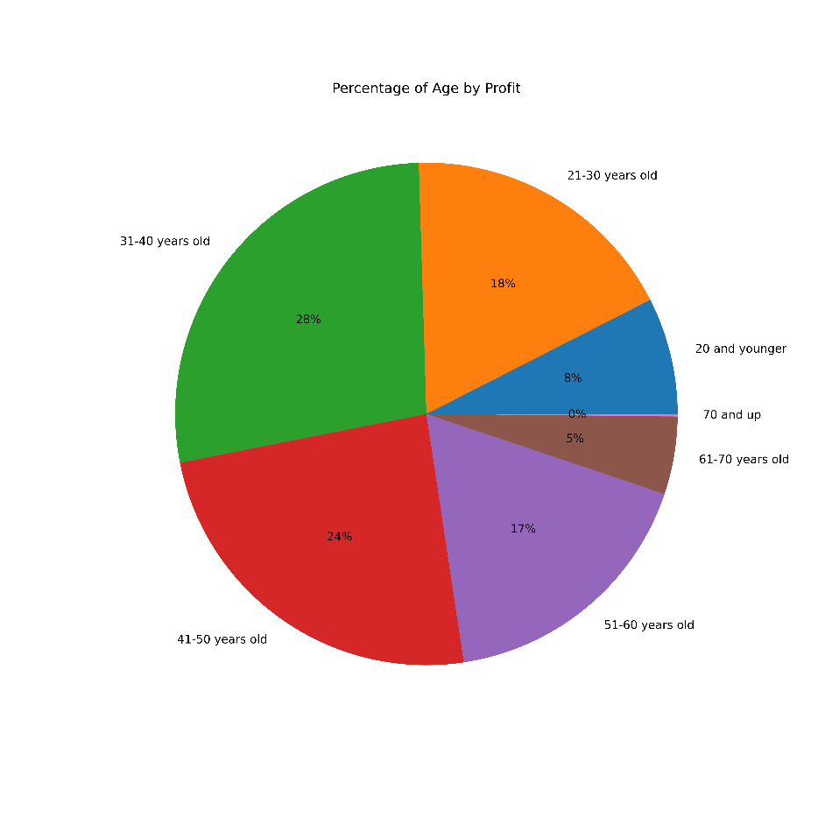
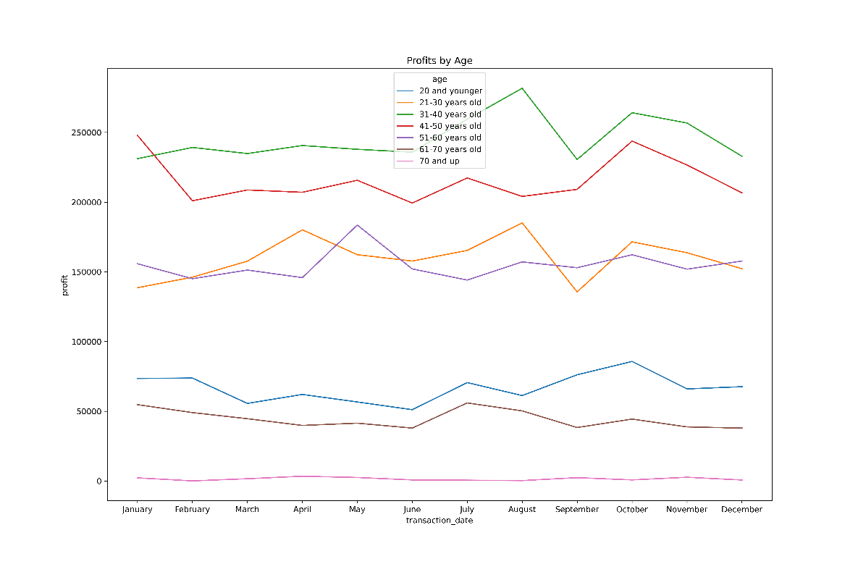
Note: The data and information in this document is reflective of a hypothetical situation and client. This document is to be used for KPMG Virtual Internship purposes only.
Data Exploration
Total Profit by Age Group
The largest market is between 30-50 years old at combined total profit of ~$500k in 2017

Slide 9
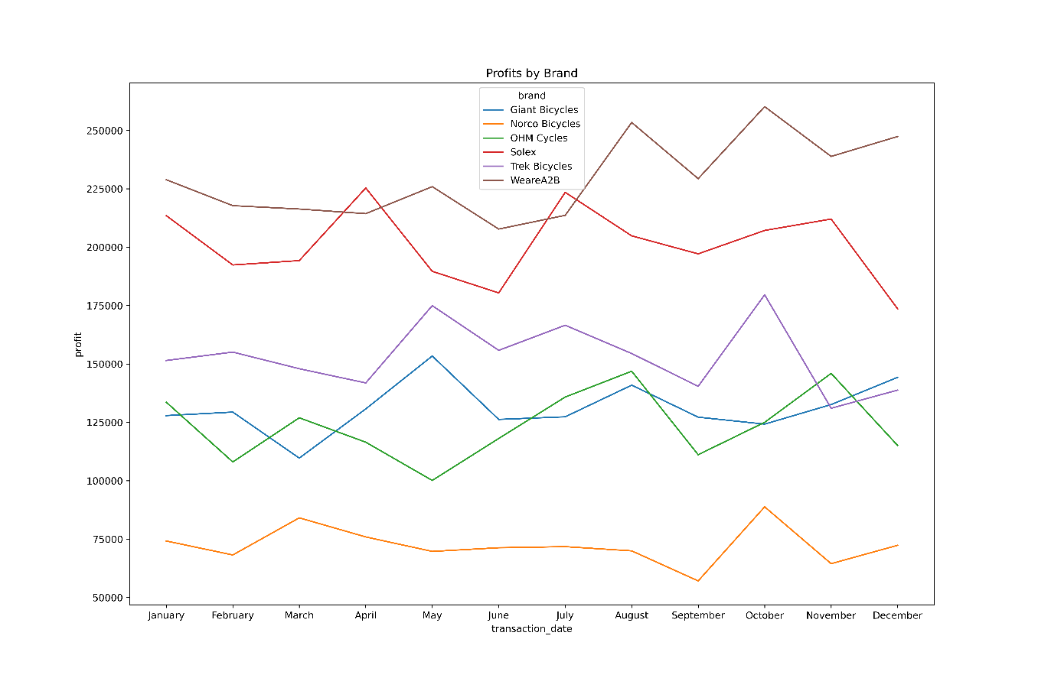
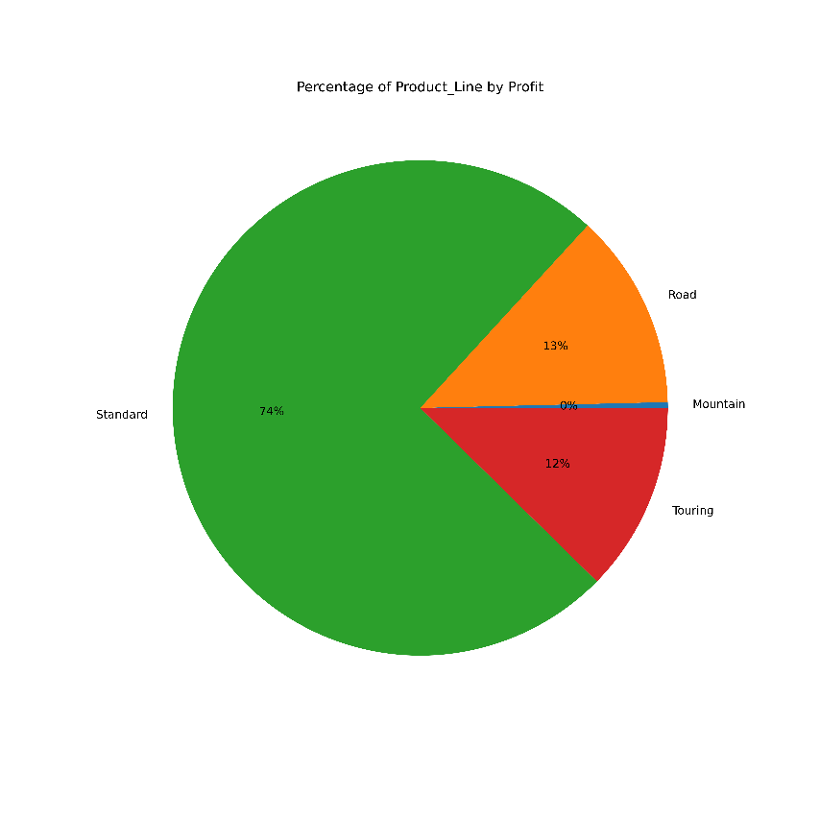
Note: The data and information in this document is reflective of a hypothetical situation and client. This document is to be used for KPMG Virtual Internship purposes only.
Data Exploration
Total Profit by Brand & Product Line
Profitable brands: WEareA2B and Solex
Profitable product line: Standard Bikes

Slide 10
Note: The data and information in this document is reflective of a hypothetical situation and client. This document is to be used for KPMG Virtual Internship purposes only.
Model Development
Tasks
Feature engineering and Pre-processing
Dropping irrelevant features, filling in missing values, and transforming the data
Models will include Random Forest, Categorical Boosting, and KNN to predict which customers are most likely to make purchases
We will determine which demographics are most important to focus our marketing strategy on

Slide 11
Note: The data and information in this document is reflective of a hypothetical situation and client. This document is to be used for KPMG Virtual Internship purposes only.
Interpretation
Marketing Strategy
Most purchases are made later in the year around the spring time when most people are outdoors in Australia; Sprocket should begin preparing for this season and uptick in bike purchases
Sprocket should focus on selling and increasing their inventory on Standard bikes from WeareA2B and Solex during this time period
Based on total profits from 2017, Sprocket should focus on the following demographics: Customers in their 40s, Mass consumers, and customers that work in the Manufacturing and Financial industry

Slide 12
Note: The data and information in this document is reflective of a hypothetical situation and client. This document is to be used for KPMG Virtual Internship purposes only.
Appendix

Slide 13
Note: The data and information in this document is reflective of a hypothetical situation and client. This document is to be used for KPMG Virtual Internship purposes only.
Appendix
You can find the cleaned dataset and the full analysis on GitHub.

